Slide 1


Merck Supply Chain Blockchain Lab API

Slide 2
Product Attribute Dictionary
Attribute | Description
gtin | The Global Trade Item Number (GTIN) can be used by a company to uniquely identify all of its trade items.
serialNumber | Serial Number is the identifier for a serial number. The value is generic and dependent on randomization, either consecutively numbered or it is a random value.
lotNumber | The LOT number is not a unique identifier for a batch (LOT).
expiryDate | The Expiry Date shows the date when a serialized trade item or batch expires.
mfgDateTime | The Manufacturing Date shows the date when a batch, and therefore all serialized trade items belonging to that batch, has been produced.
tradeItemDesc | Name of the drug
logisticStatus | The Logistic Status describes where the object is currently located. For example, an object can be in status received or stocked.
packStatus | The Pack Status describes the current level of an object in the packing hierarchy.
Product key

Slide 3
Product Attribute Dictionary cont’d…
Attribute | Description
packStatus | The Pack Status describes the current level of an object in the packing hierarchy.
disposition | The Disposition describes the current business condition of the object. The Disposition can be changed accordingly by EPCIS events. The value given for the disposition in the events is mapped to the processed objects as new disposition value. Ex: Active, Returned, Destroyed, etc,.
globalLocationNumber | The Global Location Number (GLN) is used to identify locations.
objectStatus | Represents the current status of the object. The object status has different possible values that describe how the object can be accessed. Active objects are generally open to changes, while visible objects can only be observed and invalidated objects are not valid for any processing anymore
epicIdUri | This is an encoded EPC URI Identifier.
gs1ElementString | This is an encoded GS1 Element String.
country | The profile relevant country is a dedicated country within the list of country assignments of a trade item. The profile relevant country is used both for determination of the country for serial number management and regulatory reporting.

Slide 4
Product Attribute Dictionary cont’d…
Attribute | Description
deliveryNumber | The delivery number of the sold package to our customers
filename | File name that contains the artwork for the drug
extraAttribute1 | Extra hashed value (can be anything) *This attribute is hashed when stored in the blockchain. This can be useful for storing sensitive information, such as product fingerprints or other information that you don’t wait to be retrievable from the blockchain
extraAttribute2 | Extra hashed value (can be anything) *This attribute is hashed when stored in the blockchain. This can be useful for storing sensitive information, such as product fingerprints or other information that you don’t wait to be retrievable from the blockchain
longitude | Longitude of scan
latitude | Latitude of scan

Slide 5
API Endpoints

Slide 6
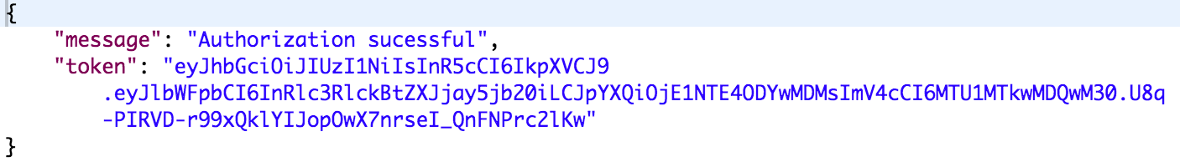
Authorization
Endpoint URL: https://mercklab-poc-sl-api.mybluemix.net/api/user/login
Endpoint Method: POST
Endpoint Functionality: This endpoint retrieves a token to use as for authorizing all other requests made to the Blockchain lab API
Sample Headers: Please reference Postman collection
Sample Body: Please reference Postman collection
Sample response:

Slide 7
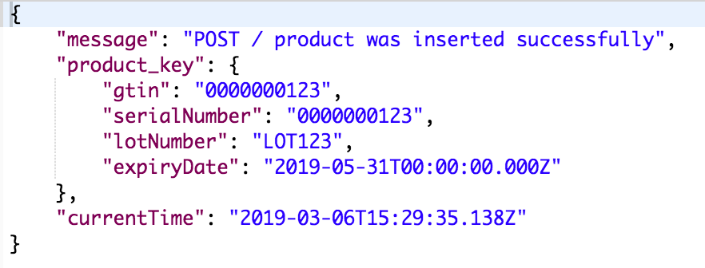
Add single product
Endpoint URL: https://mercklab-poc-sl-api.mybluemix.net/api/products
Endpoint Method: POST
Endpoint Functionality: This endpoint adds a single product to the Blockchain
Sample Headers: Please reference Postman collection
Sample Body: Please reference Postman collection
Sample response:

Slide 8
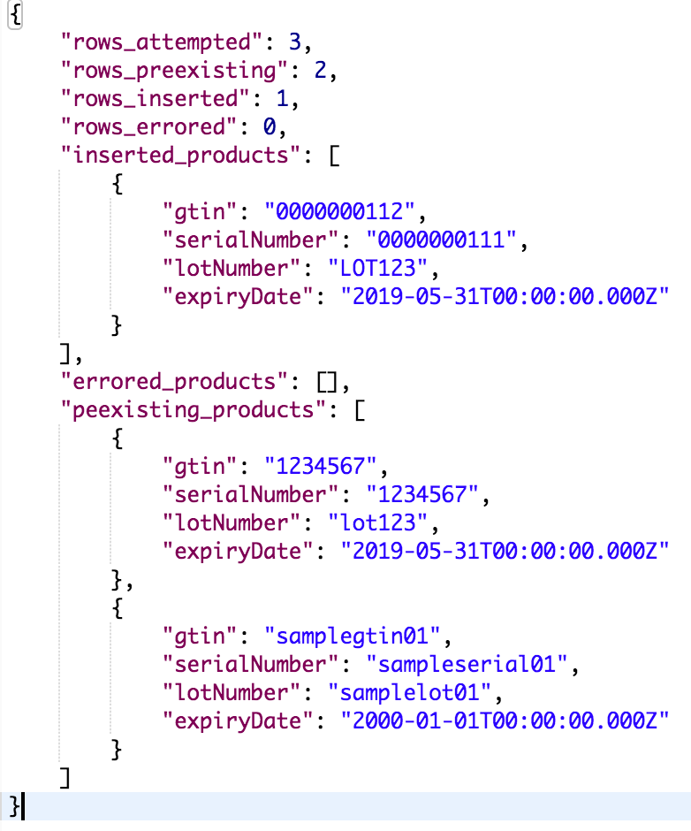
Add multiple products
Endpoint URL: https://mercklab-poc-sl-api.mybluemix.net/api/products/writebulk
Endpoint Method: POST
Endpoint Functionality: This endpoint adds multiple products to the Blockchain
Sample Headers: Please reference Postman collection
Sample Body: Please reference Postman collection
Sample response:

Slide 9
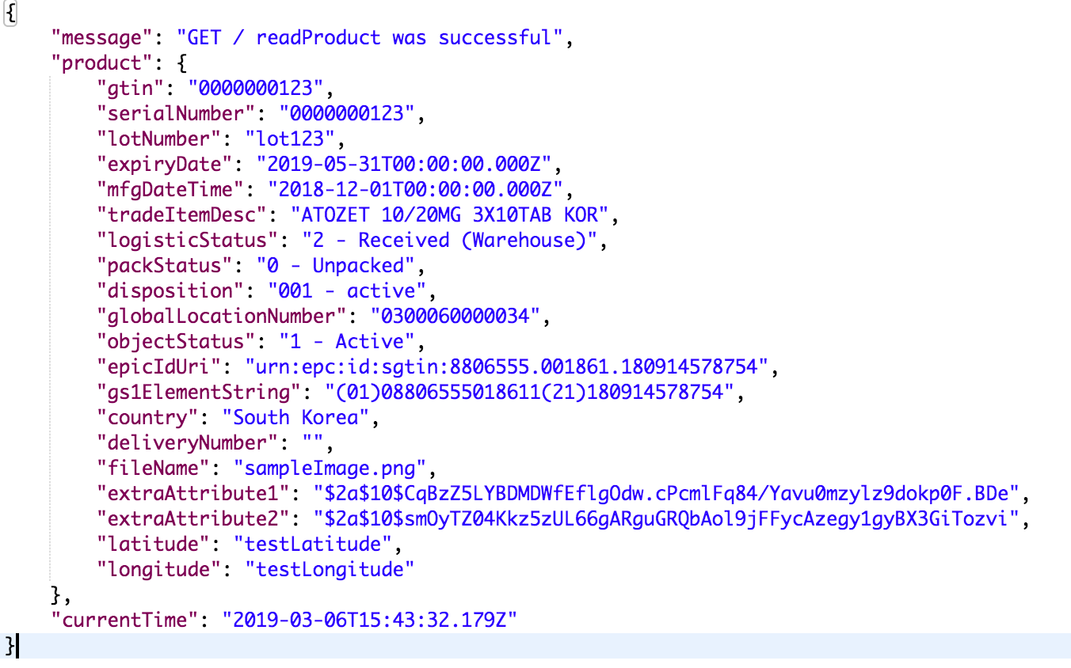
Read single product
Endpoint URL:
https://mercklab-poc-sl-api.mybluemix.net/api/products/{product GTIN}/serialNumber/{product serial number}/lotNumber/{product lot number}/expiryDate/{product expiration date}
Endpoint Method: GET
Endpoint Functionality: This endpoint reads a single product from the Blockchain
Sample Headers: Please reference Postman collection
Sample response:
*only hashed values are returned for extraAttributes 1&2 – to verify these attributes, see the Verify extra attributes endpoint

Slide 10
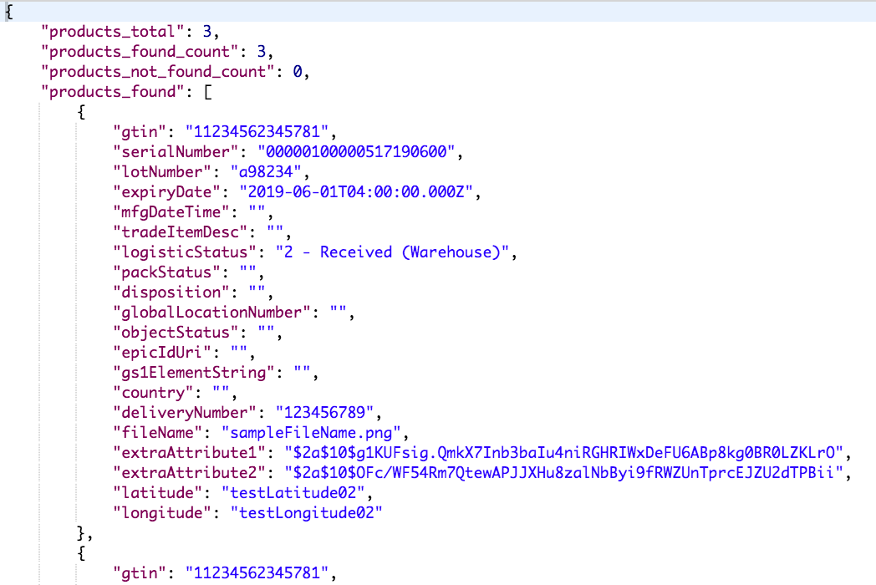
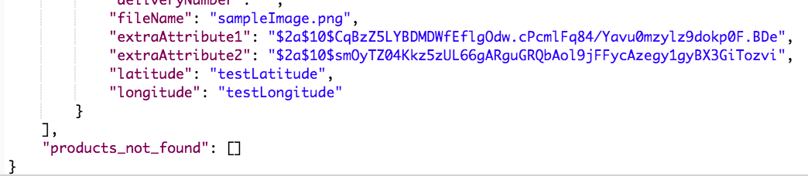
Read multiple products
Endpoint URL: https://mercklab-poc-sl-api.mybluemix.net/api/products/readbulk
Endpoint Method: POST
Endpoint Functionality: This endpoint reads multiple products from the Blockchain
Sample Headers: Please reference Postman collection
Sample Body: Please reference Postman collection
Sample response:
…

Slide 11
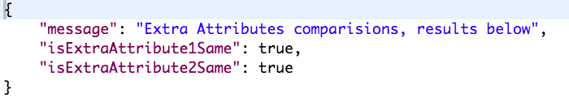
Verify Extra Attributes
Endpoint URL: https://mercklab-poc-sl-api.mybluemix.net/api/products/verifyxattrs/{product GTIN}/serialNumber/{product serial number}/lotNumber/{product lot number}/expiryDate/{product expiration date}
Endpoint Method: POST
Endpoint Functionality: This endpoint verifies that the “extraAttribute1” and “extraAttribute 2” for any given product key are identical to the ones provided in the body of this request
Sample Headers: Please reference Postman collection
Sample Body: Please reference Postman collection
Sample response:

Slide 12
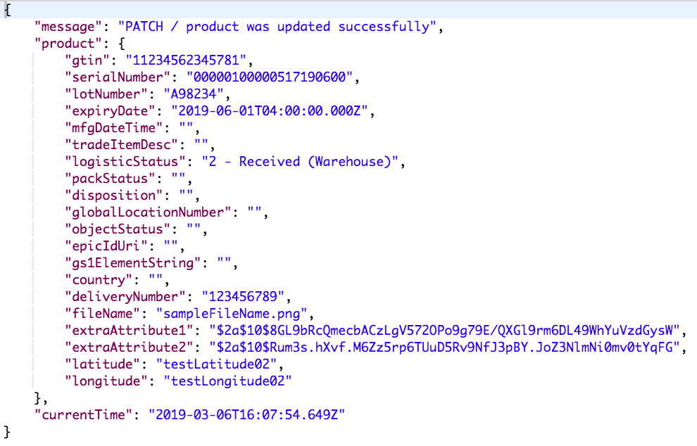
Update single product
Endpoint URL: https://mercklab-poc-sl-api.mybluemix.net/api/products/{product GTIN}/serialNumber/{product serial number}/lotNumber/{product lot number}/expiryDate/{product expiration date}
Endpoint Method: PATCH
Endpoint Functionality: This endpoint updates the attributes for a single product on the Blockchain, given the product keys
Sample Headers: Please reference Postman collection
Sample Body: Please reference Postman collection
Sample response:

Slide 13
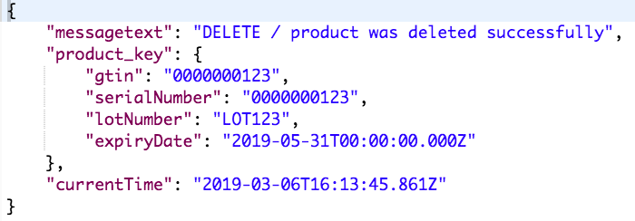
Delete single product
Endpoint URL: https://mercklab-poc-sl-api.mybluemix.net/api/products/{product GTIN}/serialNumber/{product serial number}/lotNumber/{product lot number}/expiryDate/{product expiration date}
Endpoint Method: DELETE
Endpoint Functionality: This endpoint pseudo-deletes a single product on the Blockchain, given the product keys
Sample Headers: Please reference Postman collection
Sample response:

Slide 14
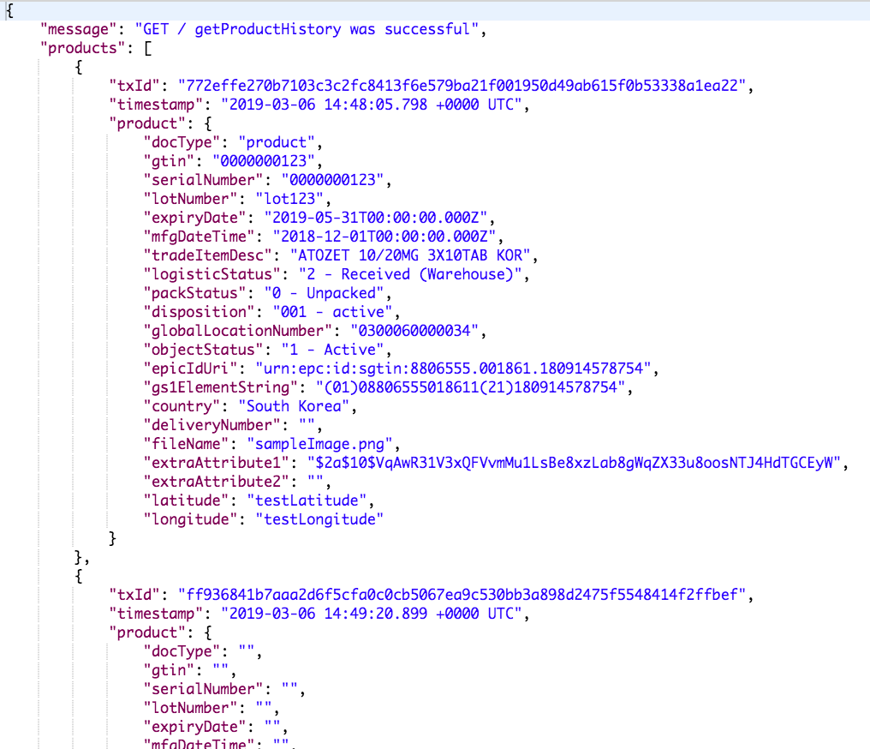
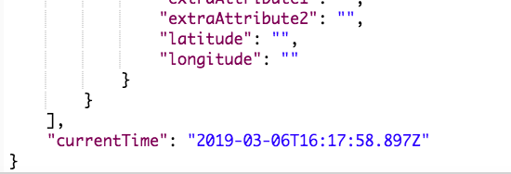
Get history of single product
Endpoint URL: https://mercklab-poc-sl-api.mybluemix.net/api/products/gethistory/{product GTIN}/serialNumber/{product serial number}/lotNumber/{product lot number}/expiryDate/{product expiration date}
Endpoint Method: GET
Endpoint Functionality: This endpoint retrieves the history of a single product on the Blockchain, given the product keys. The history that is retrieved includes product insertions, deletions, and updates.
Sample Headers: Please reference Postman collection
Sample response:
…

